Slide 1

Dominic Ross
CMU – III – OSS
OSS FFRDC Maturity Evaluation
Image
created by
Craiyon
Notes:
Hello I am Dominic Ross, and I am going to talk with you about FFRDC Maturity.

Slide 2
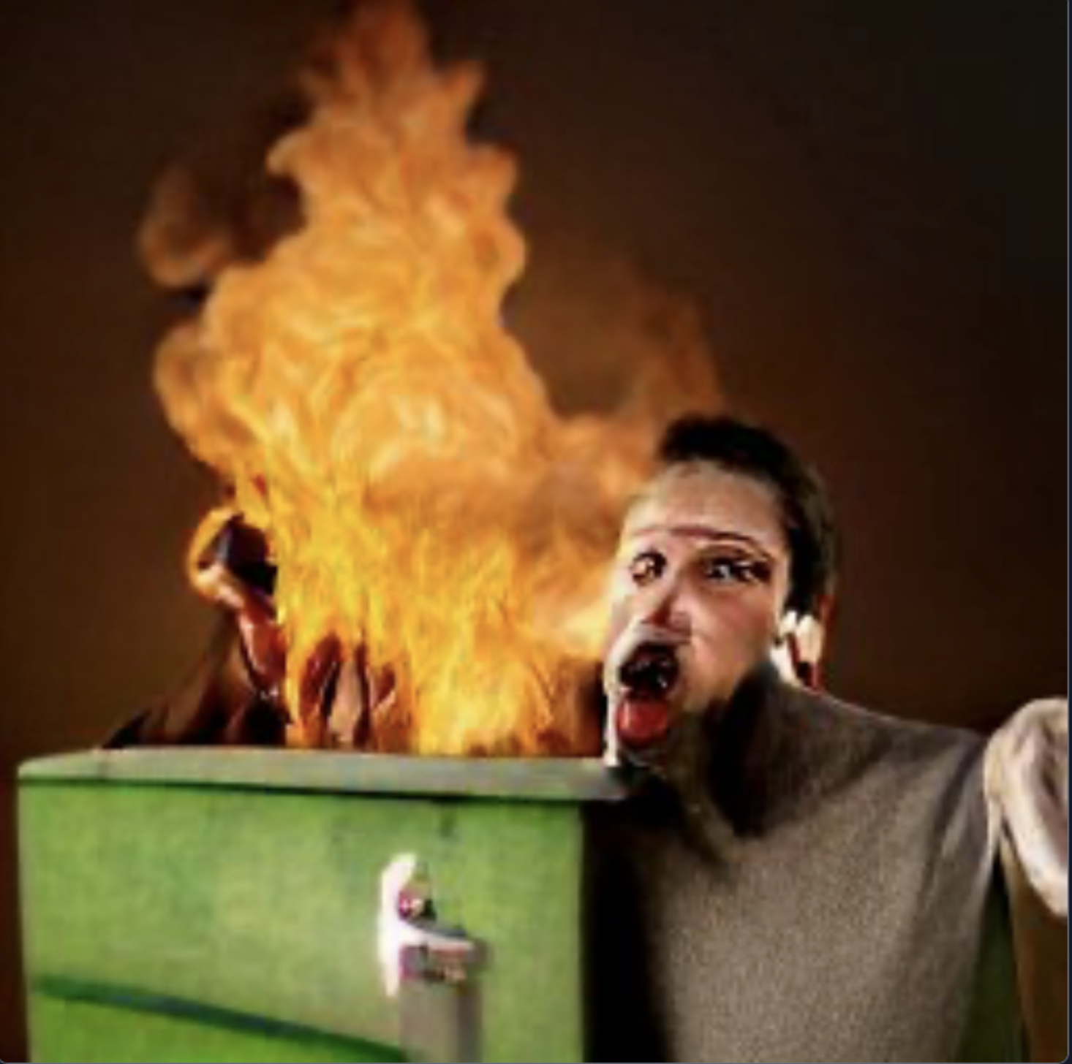
Just to be 100% Clear
This is a student project.
The information contained in this presentation is a general evaluation of how some FFRDC’s handle Open Source and is not meant to be a reflection or disclosure of information about any single FFRDC.
Participants come from a variety of FFRDCs.
The FFRDCs will never be named and I do not represent any FFRDC for this project.
This presentation should not be considered a statement or factual representation by any FFRDC. Again STUDENT PROJECT!
This presentation doesn’t represent the DoD either, in any way.
Did I mention this is a student project?
Please check with your own organization prior to implementing any recommendations.
Image
created by
Craiyon
Notes:
Before we get started I am basically saying don’t turn my life into a dumpster fire, I am not saying someone from legal had a talk with me but I am saying this report is not sponsored by a FFRDC.

Slide 3

Whats is a FFRDC?
Federally Funded Research and Development Centers (FFRDC) are private sector organizations tasked with assisting the U.S. government with long-term research and development.
Special access to government data and funding result in FFRDCs having to follow strict guidelines on what work they may accept.
Employees of FFRDCs are considered to be government contractors and must follow government policies.
FFRDCs must be free of organizational and employee conflicts of interest and cannot compete for work, except for the right to operate an FFRDC.
Image
created by
Craiyon
Notes:
A FFRDC is a Federally Funded research and development center, kinda like your industry but with a government oversight
We are considered government contractors so we have to follow their policies.
Our sponsor can decide what we can work on, who and can work with, and whether our work can be seen by the public.

Slide 4
I started with a Lit Review to see how FFRDCs are different...
What was I looking for?
FFRDC OSS established procedures for release, contributions, licensing, management and maintenance.
Identify mature Industry OSS established procedures for release, contributions, licensing, management and maintenance.
Recorded with
OBS
Notes:
I didn’t really know where to start, so I started reviewing whatever information I could find in hopes that I could find established documented processes for FFRDCs.
I could not.
But I did find a lot of great information. More than I could expect the Average employee to read.
So I knew a short report with direct links would be a better resource

Slide 5
OSS Challenges for FFRDCs that Enterprises may not face...
Enterprise OSS Expectations
FFRDC OSS Realities
TODO Is a Great Resource! Here are some resource guide topics written for the enterprise perspective that stood out.
1. Participating in the OSS Community
2. Recruiting Open Source Developers
3. Starting a Open Source Project
4. Shutting Down OSS Project
5. Maintaining OSS Projects
6. Marketing OSS Projects
1. Could be considered a conflict of interest without sponsorship approval.
2. No software can be published without sponsorship approval. Approval process can be lengthy, months to years. Competitive job market a real struggle for FFRDCs to compete with enterprises. Misinformation and checks and balances could frustrate OSS talent.
3. Without prior approval most projects are considered to be restricted, so you may need approval prior to starting a OSS project from the start.
4. The sponsor could cut funding at any moment causing you to sunset a OSS project prior to roadmap.
5. Pushing new code and features requires additional review. Funding may end when you make the project public not allowing you to maintain it. Working on it in your own time could be a conflict of interest.
6. Sponsors and FFRDCs do not always want project exposure raised.
Notes:
Professor Wasserman early on also directed me to the TODO Group which was awesome. Almost every piece of info I needed to get started was there. The only problem was it is written from industries perspective and not the reality many FFRDC employees face.
I noted valuable info in the report and made note when someone should confirm information within their org.

Slide 6
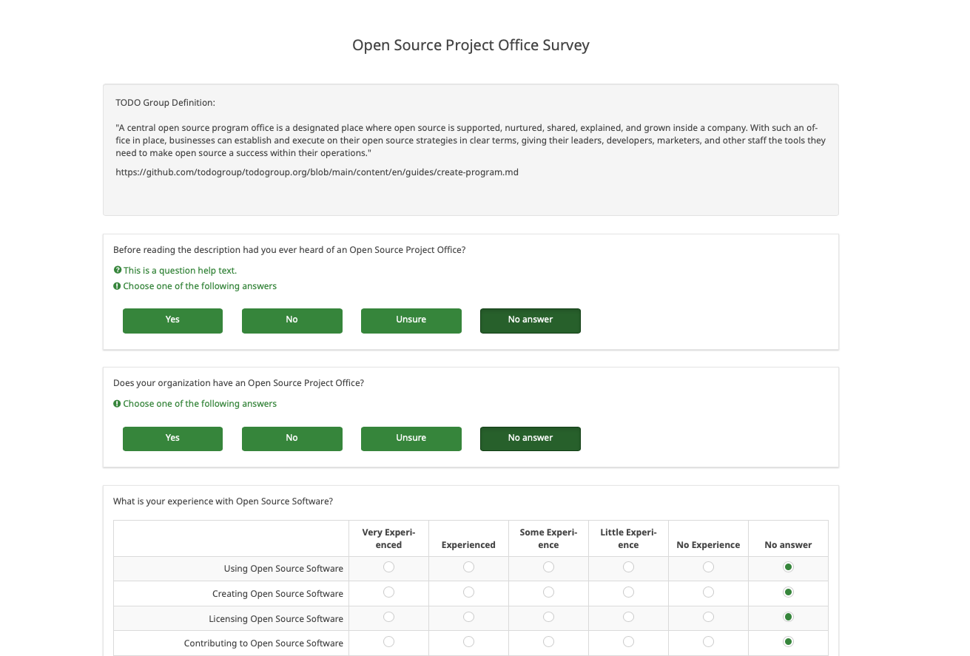
I made a survey.
8 Questions in length.
Evaluating individual OSS experience from FFRDC employees.
If they saw values in an OPSO in a FFRDC.
Employees also accessed the OSS maturity of FFRDCs they have worked with.
https://daross.limesurvey.net/593425?lang=en
Survey Created with
Limesurvey
Notes:
After my lit review I was surpised that FFRDCs would be near a Level 3, which is mature, its not great score but not bad given the many restrictions FFRDCs face.
So after the lit review I was pretty confused.
The Information was out there.
Yet, was I the only one who didn’t know this content working at a FFRDC?
Was I the only one who was drinking the kool-aid of mis-information.
So I decided to create a survey to provide additional data points.

Slide 7
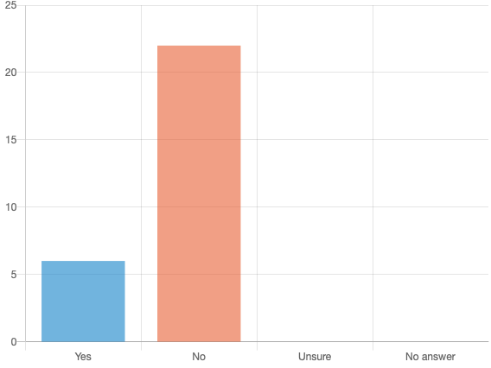
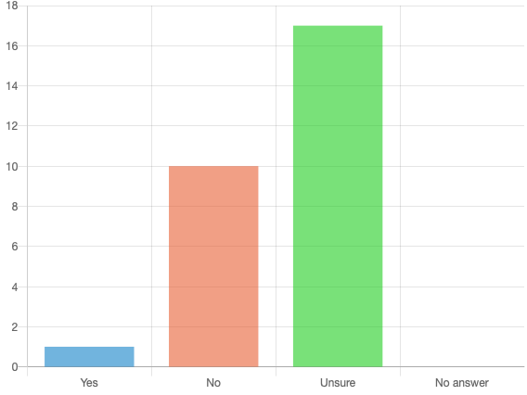
I ran an Anonymous survey.
Before reading the description had you ever heard of an Open Source Program Office?
Does your organization have an Open Source Project Office?
Notes:
Most people had never heard of a OSPO and most people had no idea if their FFRDC even had one.

Slide 8
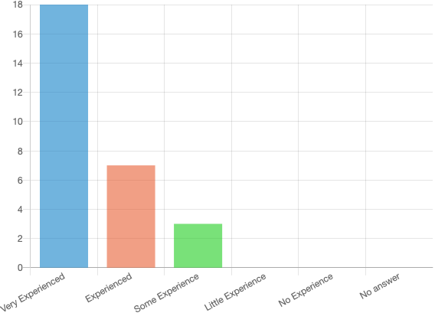
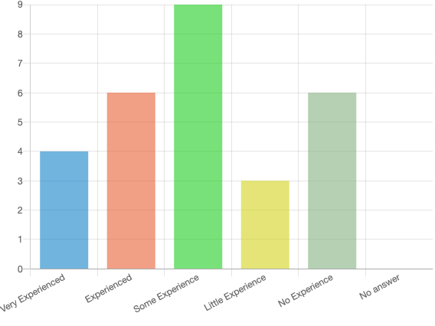
I ran an Anonymous survey.
What is your experience using OSS?
What is your experience creating OSS?
Notes:
Yet these people had experience using OSS, and most of them had experience creating it.

Slide 9
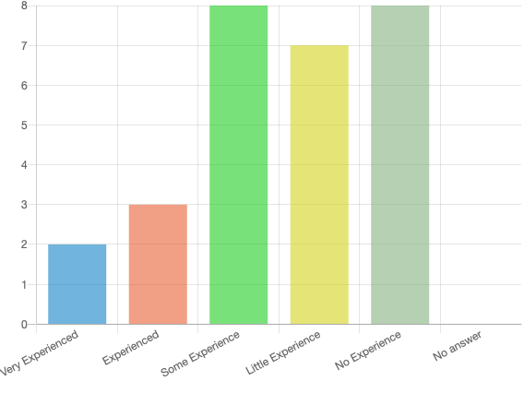
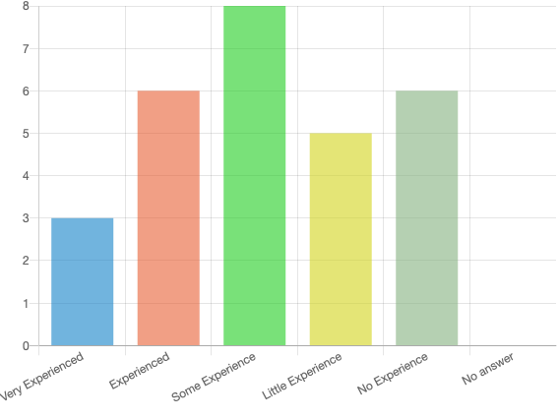
I ran an Anonymous survey.
What is your experience licensing OSS?
What is your experience contributing OSS?
Notes:
Even though they use it and build it, most wore less experienced with licensing.
We already know that contributing is difficult in a FFRDC.s so the spread result is not surprsing.

Slide 10
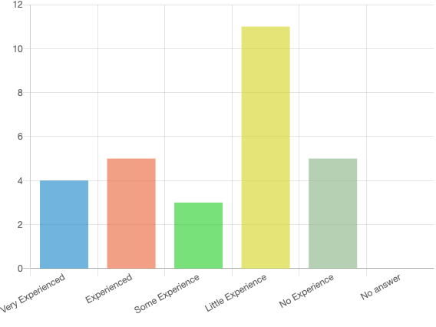
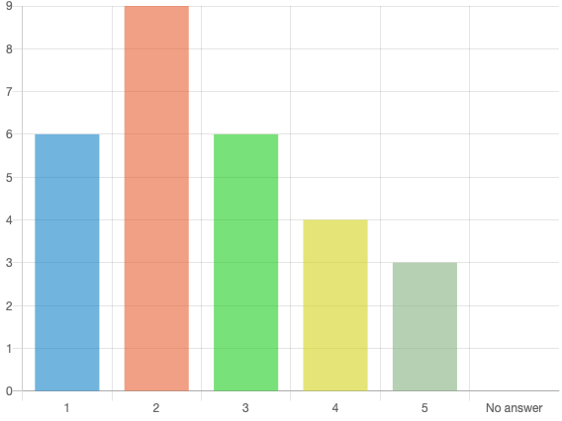
I ran an Anonymous survey.
What is your experience Distributing OSS?
OSS Resources and Documentation - You know where to go to find out information about how your organization deals with Open Source?
1 Needs Improvement 3 Average 5 Great
Notes:
Distributing OSS was a surprise, I think Github may be good enough for most.
The cracks are showing though. Most people didn’t even know where to start collecting info.

Slide 11
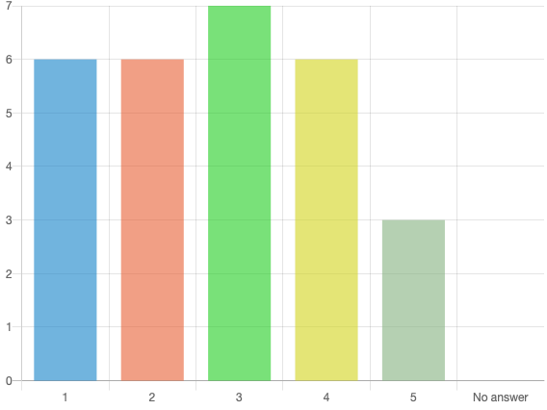
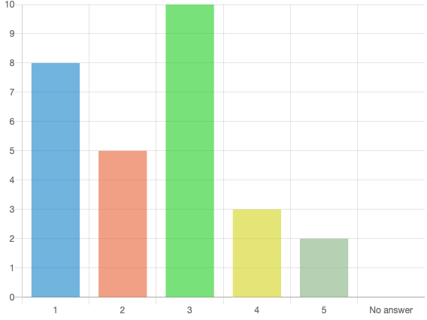
I ran an Anonymous survey.
OSS Personal Guidance - You know who to talk to at your organization?
OSS Defined Process, Policy, and Best Practices - You know how the organization wants your Open Source project to look?
1 Needs Improvement 3 Average 5 Great
1 Needs Improvement 3 Average 5 Great
Notes:
Participants felt they had some personal guidance despite not knowing where to begin.
But again point to more adhoc strategy.

Slide 12
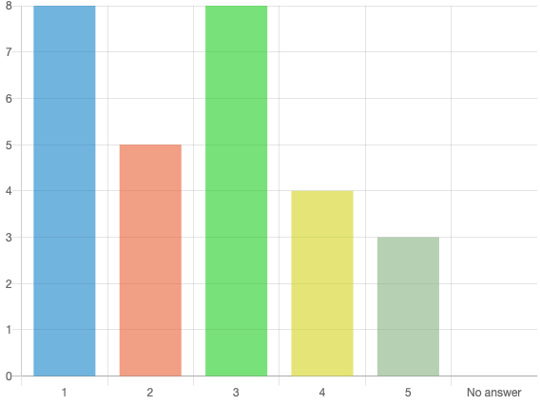
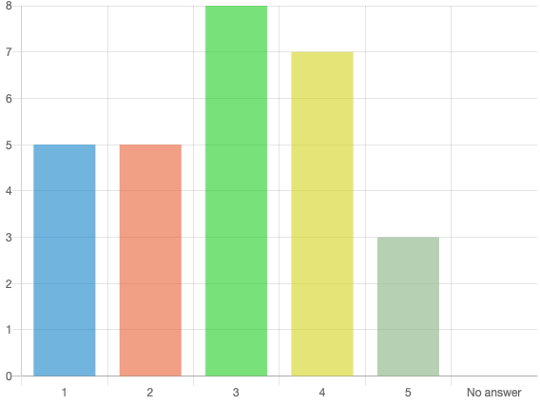
I ran an Anonymous survey.
OSS Marketing - You know that when you Open Source a project users will know how to find it?
OSS Useability - You know that when you Open Source projects, users can leverage it?
1 Needs Improvement 3 Average 5 Great
1 Needs Improvement 3 Average 5 Great
Notes:
Even if a employee succesfully published OSS they didn’t have confidence it was being properly marketed or if users could even leverage their creations.

Slide 13
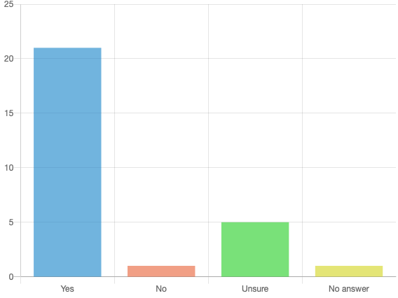
I ran an Anonymous survey.
Do you see value in an Open Source Project Office?
What we learned about FFRDC employees:
They have decent experience with consuming and creating OSS.
They somewhat understanding licensing
They do not know how the organization wants OSS releases or marketed.
They don’t always know where to get the OSS information they need.
After learning what a OSPO is they highly support the idea.
They appear qualified to evaluate their org.
Based off their initial responses I would make the assumption they believe their org OSS practices are possibly immature.
Notes:
So its no wonder why overwhelming they would support a OSPO. My experience was not unique, I am not special, FFRDC implementation of OSS may be immature.

Slide 14
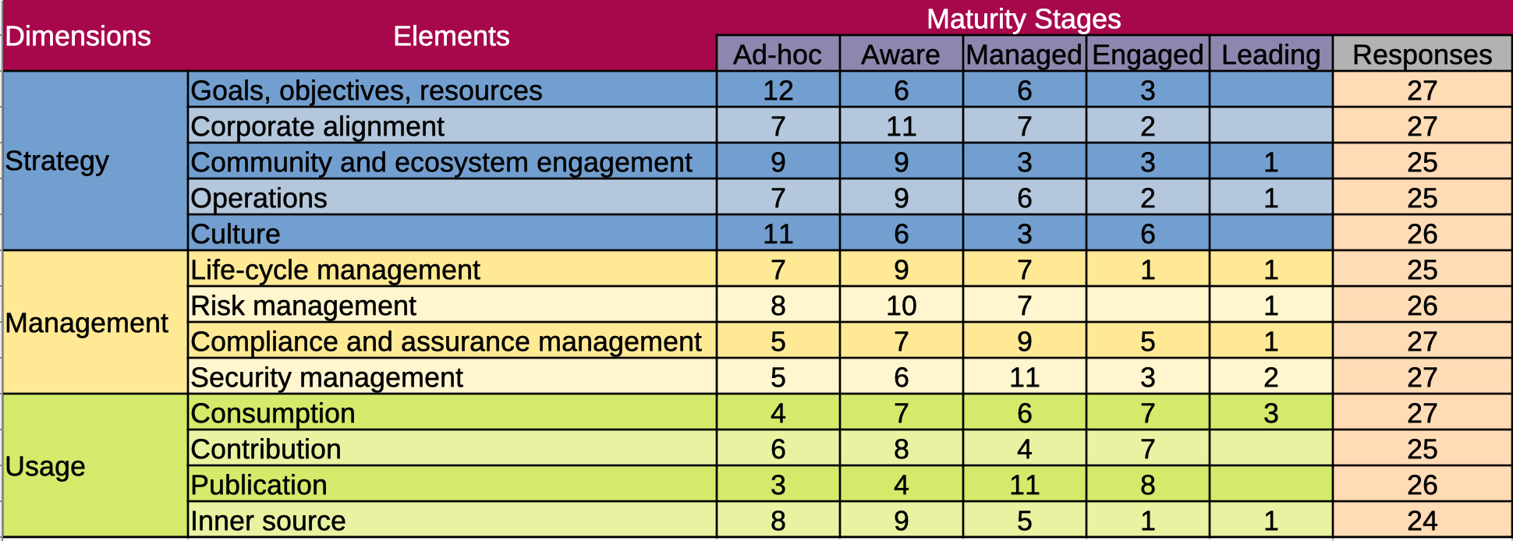
I ran an Anonymous survey.
Do you see value in an Open Source Project Office?
Created with
LibreOffice data
From LimeSurvey
Spreadsheet design influenced by
Open Source India and wipro Source Maturity Model
Notes:
So the survey dug deeper. These participants would get a chance to fill out a Maturity model.
BTW This took forever to filter out the data.

Slide 15
Survey - Maturity Stages
OSS Strategy leans immature.
Management leans mature.
Enterprise is firmly mature.
Created with LibreOffice Data From LimeSurvey
Notes:
So if we look the table we see its the left strategy categories get the majority of the Adhoc/Aware scores.
Management categories in the middle and Enterprise categories on the right are surprisingly high for a group of participants who were pretty negative for most of the survey.

Slide 16
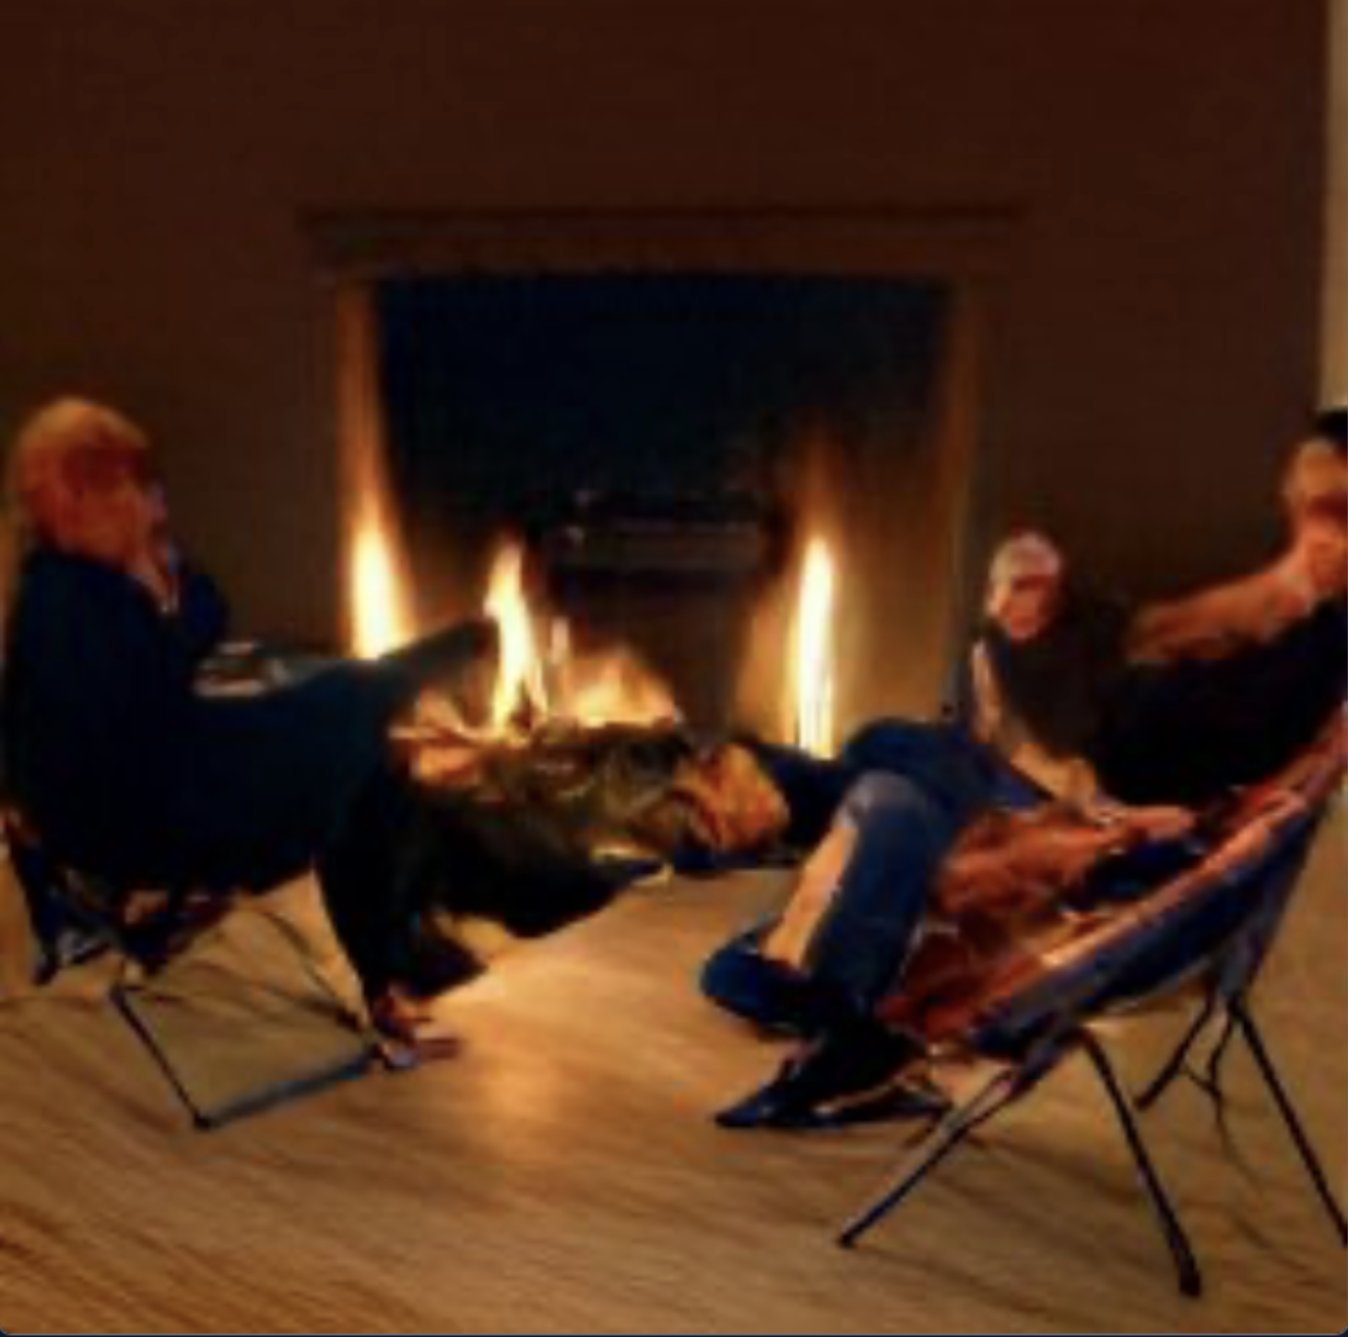
Stakeholders
The community has spoken and they demand to be heard.
Anonymous interviews were conducted to get additional feedback than the survey could provide.
The interview was not meant to be a study with results, merely a way for me to better understand the survey results.
Image
created by
Craiyon
Notes:
I got lots of pings asking if I wanted to chat in more detail. Get their points of view.
I didn’t want to do that with survey participants, but I was interested in interviewing the different roles in FFRDCs that are stakeholders in OSS.

Slide 17

Stakeholder Interviews – IT
Believes that their org may not trust that OSS is as secure as COTTS/GOTTS, but has never been officially told that. No known official policies against the use of OSS at their org but believes InfoSec and IT may discourage the use of OSS without valid justification.
Believes some of their organizational users may work around IT policy to install OSS software becomes user manage policy.
No real QA process for OSS release.
Believes their organization could benefit from an OSPO.
Notes:
I started with IT, at many FFRDCs they control the organizations github page.
My overall impression is a cynical thought process toward OSS.
Many speculative answers without providing evidence to back up the response.
I got the impression that if the organization had larger staffing in IT that they believed they could do a better job growing OSS maturity

Slide 18

Stakeholder Interviews - Engineer
Licensing challenges, it is up to me to have a license reviewed. In my org, a second review happens after the software is created which can cause changes.
Doesn't know if new features require additional review by their org.
Doesn't feel supported in creating OSS in their org.
Believes that If you open source software you have to maintain it. As a programmer I just want people to use my stuff. The community is important, and the point of OSS.
Analytics from repos help drive personal motivation and satisfaction.
Doesn't work on outside OSS projects anymore and doesn't think it would count towards career advancement in their org.
Image
created by
Craiyon
Notes:
My overall impression is that they felt OSS was important to their personal development and career growth but not valued as much as they would expect from their organization.
When continuing questioning past initial organizational OSS frustration, more candid responses revealed a desire for their contributions to be evaluated the same way a written publication would be.

Slide 19

Stakeholder Interviews - Researcher
Follows ABC – Adopt, Buy, Create
Checks licensing and don't want to fall in love with code they ultimately they cant use.
Hates software with licenses designed to extract additional revenue that does not provide additionally needed features.
Runs licenses by ethics and compliance/legal before integrating OSS.
Does not know the internal process for release approval of OSS in their org.
Does not know if resources are available for OSS release quality assurance in their org.
Unsure if their org wants them to be an active member in the OSS community.
Unsure if an OSPO could be successful in their org.
Image
created by
Craiyon
Notes:
For the most part, they felt like their organization did an average job with dealing with OSS, but that does not mean they didn't think there was room for organizational improvement.
The researcher seemed to understand OSS licensing better which gave them a better understanding of why some organizational policies were in place but did not necessarily know what organizational support was available.
Ultimately though that the governance an FFRDC must follow made an OSPO irrelevant.

Slide 20
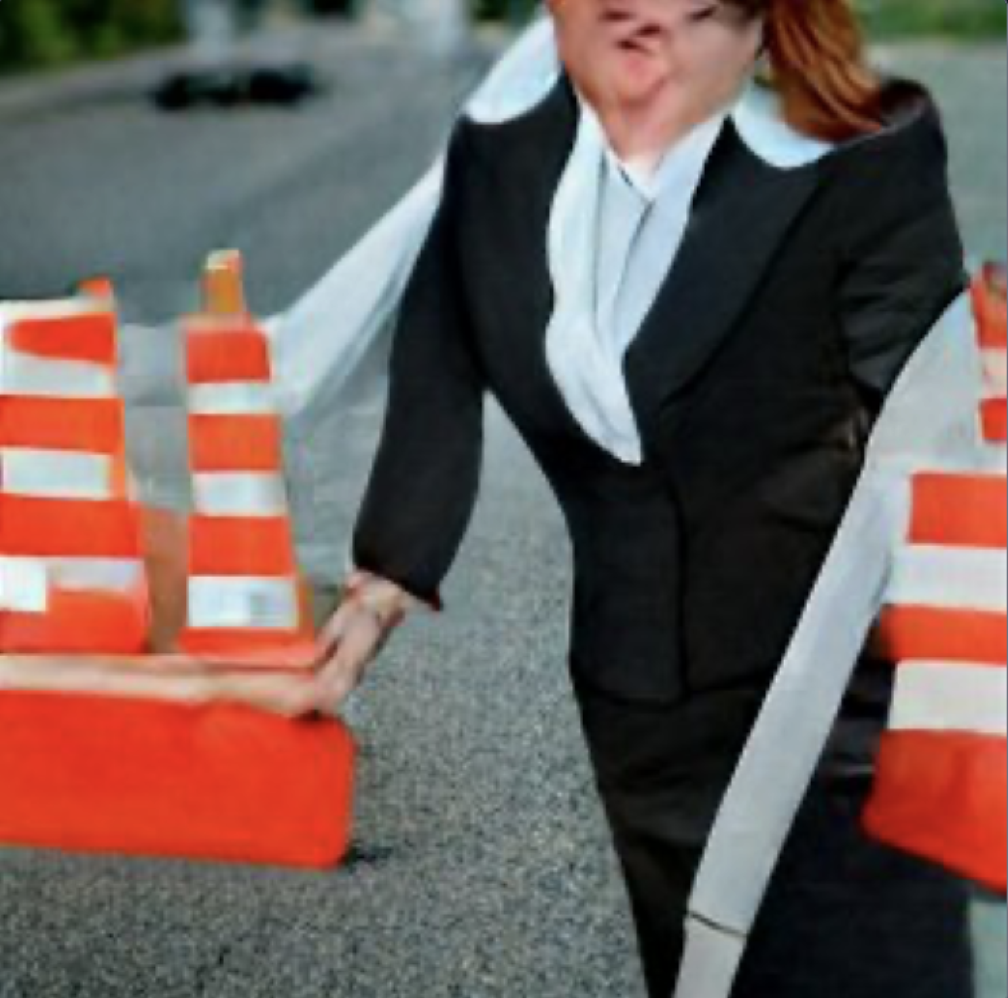
Stakeholder Interviews – Review and Approval
!!!!NOT TO BE CONSIDERED LEGAL ADVICE
Starts with reviewing your organization their terms and agreements with its sponsors to ensure you are not violating any information disclosure causes.
When you use other software with varying licenses it is good practice to have your legal department review the terms of licenses to make sure you can comply with them.
After your organization approves it, it may have to go to your organizations funding sponsor to clear for open release.
After it is approved by all parties you should be good to publish
Any updates to the project may require additional review. Check with your organization.
Collaboration activity can be viewed as a conflict of interest, check with your org.
Super Nice BTW.
Image
created by
Craiyon
Notes:
First off they wanted to make clear this is a candid conversation, not to be considered legal advice and that anyone should check with their organization for OSS review and approval policies.
Ultimately they protect the organization and the employee. Many interviewees expressed frustration with the process of dealing with review and approval, after my interviews I believe this to be unfounded.
What it reveals is a lack of process transparency, I believe better documentation and outreach would help.

Slide 21

Stakeholder Interviews - OSS Expert
A, B, and C as well as security concerns are your due diligence, long-term project, and willingness to maintain it.
Believes OPSOs are popular at most small and large companies but does not see a specific need for an OSPO at all organizations.
Likes the ideas of OPSO++ traditional OSPO which creates a substrate for boarding addition groups
Just because you create a great application doesn't mean it will inspire collaboration
Believes FFRDCS prefers to operate in Silos
Believes Linux best practices badges don't necessarily match the scorecard
Believes without evidence the maturity level is pointless
Believes that to incentive OSS contributions, they must be notable contributions that can be relevant to a DoD mission priority.
Review and Approval are important. If something goes wrong jobs could be at stake, CYA
Image
created by
Craiyon
Notes:
The OSS expert confirmed nearly everything mentioned in other interviews but also gave the counterpoint to why FFRDCs operated in that manner.
Easily the most grounded interview. They liked the idea of OSPOs but did not necessarily believe every organization needs one, especially if they can access an OSPO office through OSPO++.
The OSS expert did not believe in assigning a maturity level to an organization, as many assessments could be flawed and without definitive proof.

Slide 22

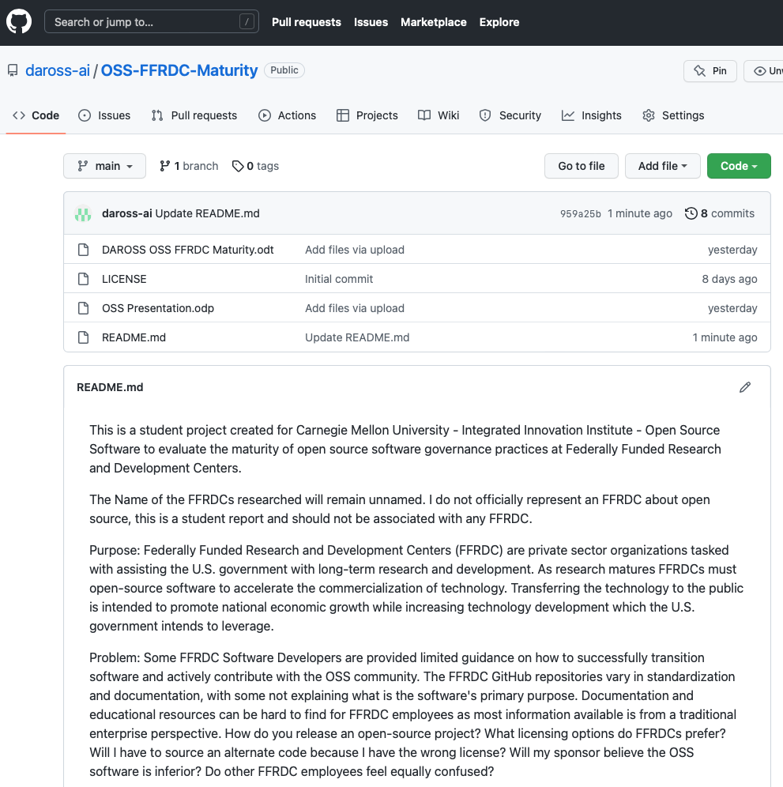
What have we learned...
I believe the survey confirms most FFRDCs have mature OSS polices shaped by the restrictions of its sponsorship governance.
Non FFRDCs have a greater opportunity for OSS collaboration but a OSS community is what you make of it.
employees want to actively participate withing the OSS community.
The DoD openly encourages OSS.
FFRDCs mission aligns with transition software by open sourcing.
The way a FFRDC is structured makes it difficult to participate in the OSS community the same way nonprofits and for profit companies can.
A lack of OSS process transparency causes confusion and unfair immaturity labeling.
I believe FFRDC OSS polices are mature but that does not mean there is not room for improvement.
Professor Wasserman said I most likely couldn’t get everything I wanted done in a six week class and he was right.
For more detailed information please visit the GitHub OSS-FFRDC-Maturity https://github.com/daross-ai/OSS-FFRDC-Maturity
Image
created by
Craiyon
Notes:
Ok with the Lit Review, Survey, and Interviews I was ready to make my decision.
Expect I wasn't. I agree with the OSS expert, the assessment value has no value. If I compare an FFRDC vs a traditional tech org I am always going to believe its immature.
Yet, violating sponsorship can cost people jobs, so a more bureaucratic process is needed. So from that standpoint the org appears mature. The one thing I know for sure after all this is the OSS is dependent on the community. I had over 30 people spend a tremendous amount of their free time to help me with a student project. Thats the start of OSS maturity.
You can find the report and resources on my Github page.

Slide 23

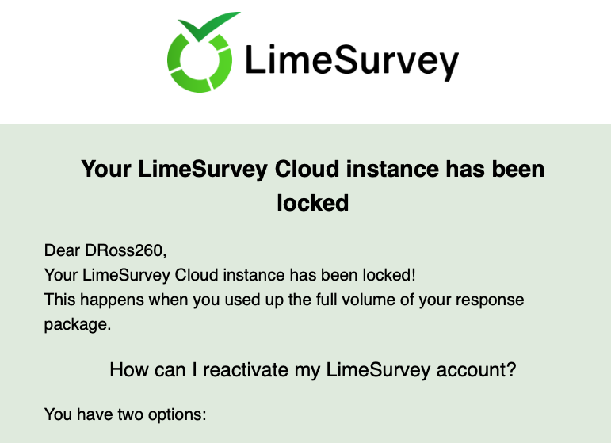
Dom’s OSS Mind Blowers!
GIF created
with GIMP
Paying for software in 2022 is kinda hard to justify.
Limesurvey locks you out of the platform if you exceed 25 responses on a free account. I thought it just stopped allowing users to post.
The DoD advertises Support of Open Source. My entire career I was told they were against it.
I prefer LibreOffice to MS Office.
Gimp is pretty good, unless you are a professional there is no reason to buy photoshop.
A OSS survey can really bring out the frustration.
The OSS community is strong and passionate.
My iMac in 2000 ran VM’s better than my Macbook

